Slide 1
Epic Java 9
Gardyan Akbar

Slide 2
What we do today
Inheritance
Overview
Polymorphism
Overriding and Overloading
Binding
Exercises :))))))

Slide 3
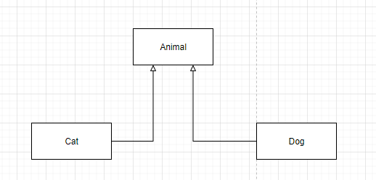
Inheritance
What is it?
Deriving a class from another class
All attributes and methods in the parent class is carried over to the child class (except for those marked as private)
The extends keyword

Slide 4
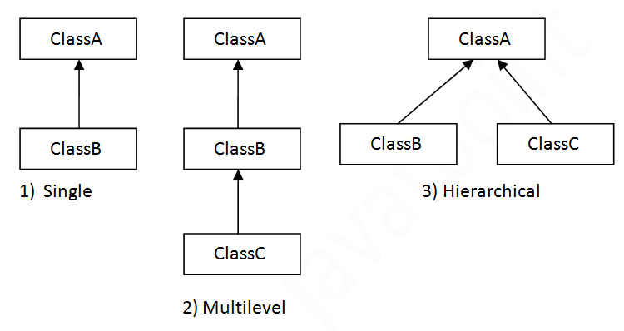
Types of Inheritance

Slide 5
Polymorphism
Aka “many forms”
When a class or a method of the same name can have multiple “forms”
Types
Static polymorphism (Overloading)
Different instances of the same named method within the same class (they are differentiated by the parameters)
Dynamic polymorphism (Overriding)
Replace code implementation of a method from the parent class

Slide 6
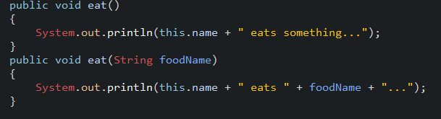
Static Polymorphism (Overloading)
Different instances of the same named method within the same class (they are differentiated by the parameters)
Animal Class

Slide 7

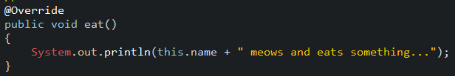
Dynamic Polymorphism (Overriding)
Replace code implementation of a method from the parent class
Animal Class
Cat Class

Slide 8




Static Binding
Aka “Early Binding”
When the type of the object is determined at compile time
Methods with private, final, or static keywords shows the existence of static binding
Output?

Slide 9


Dynamic Binding
Aka “Late Binding”
When the type of the object is determined at runtime
Output?

Slide 10
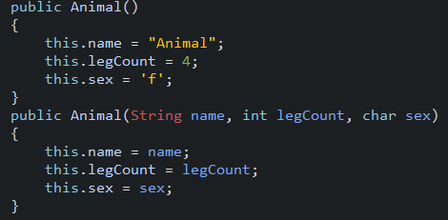
Exercises :))))))
What are the types of inheritance?
Following are the two constructors of the Animal class Can this be classified as polymorphism? If yes, what kind? If no, why not?

Slide 11
Exercises :)))))) - Continued
Look back at this code snippet: This code snippet shows dynamic polymorphism. What does the @Override keyword signify? What happens if you remove it?
Check if these are correct or wrong. State why.
Dog d = new Dog();
Animal newAnimalCat = new Cat();
Animal newAnimalDog = new Dog();
Dog temp = new Cat();

Slide 12
Ascended Exercise 1
Look back at the example at slide 8 about static binding. What can be done in order to get the proper output (the method sleep from Dog class getting called instead of Animal)
Create a simple program that implements both static and dynamic polymorphism

